Slide 1

YouTube Business model

Slide 2

Meet our team
Laiba Binta Tahir FA21-BSE-019
Arfah Ali FA21-BSE-080
Muhammad Irfan FA21-BSE-027
Slide No. 1 to 13
Slide No. 14 to 38
Content provided for Q:no:3

Slide 3
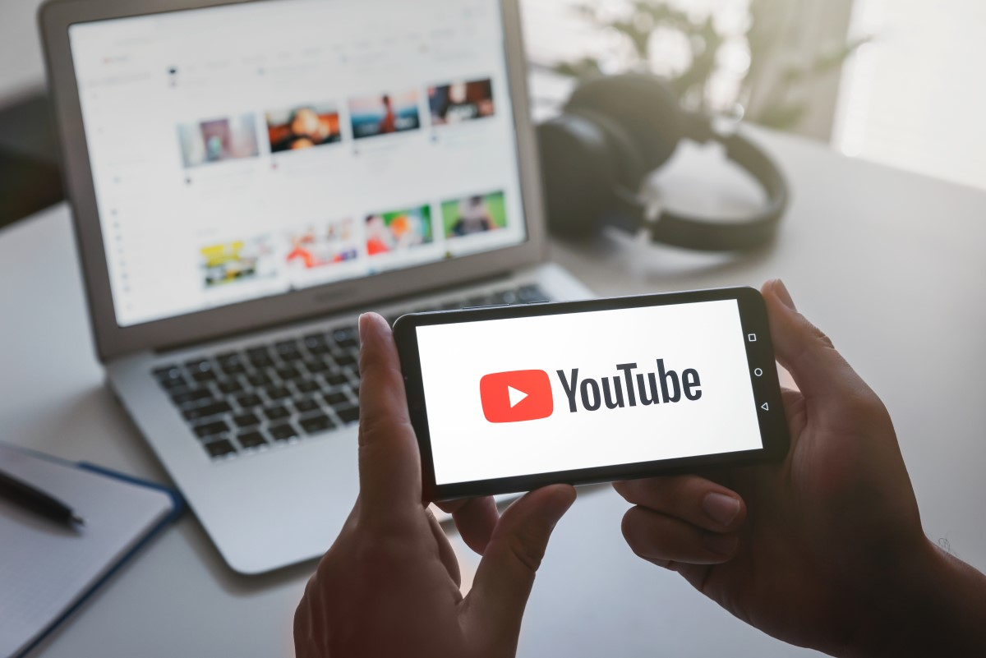
YouTube
YouTube is a Google owned website and allows its users to
Upload videos
Share and comment on other videos
Subscribe to other users’ channels
and make money by monetizing their videos. The videos are free to watch.
It also provides a specialized platform for games and music.

Slide 4


But how does YouTube make money?

Slide 5
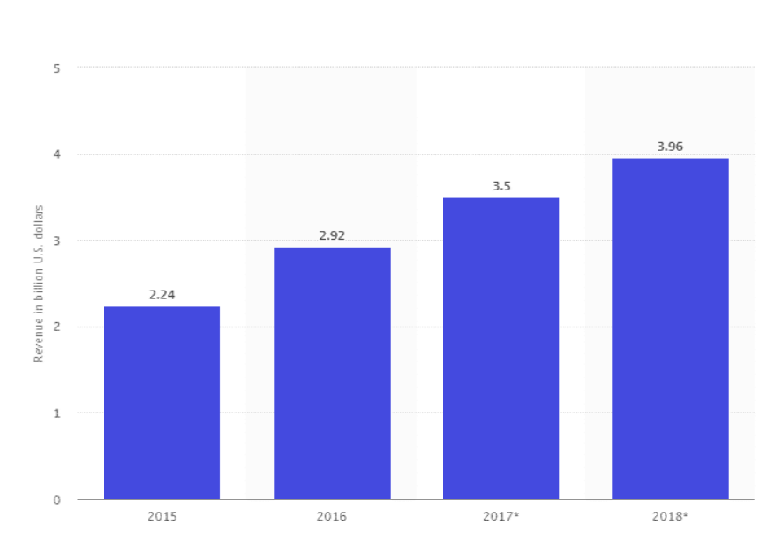
How Does YouTube Make Money?
YouTube earns most of its revenue from advertisements and represents 11% of Google’s net US ad revenues.
Company is steadily moving towards the subscription-based business model, but it is still a secondary revenue source.
YouTube Advertising revenue in the USA from 2015-2018. Source: Statista

Slide 6
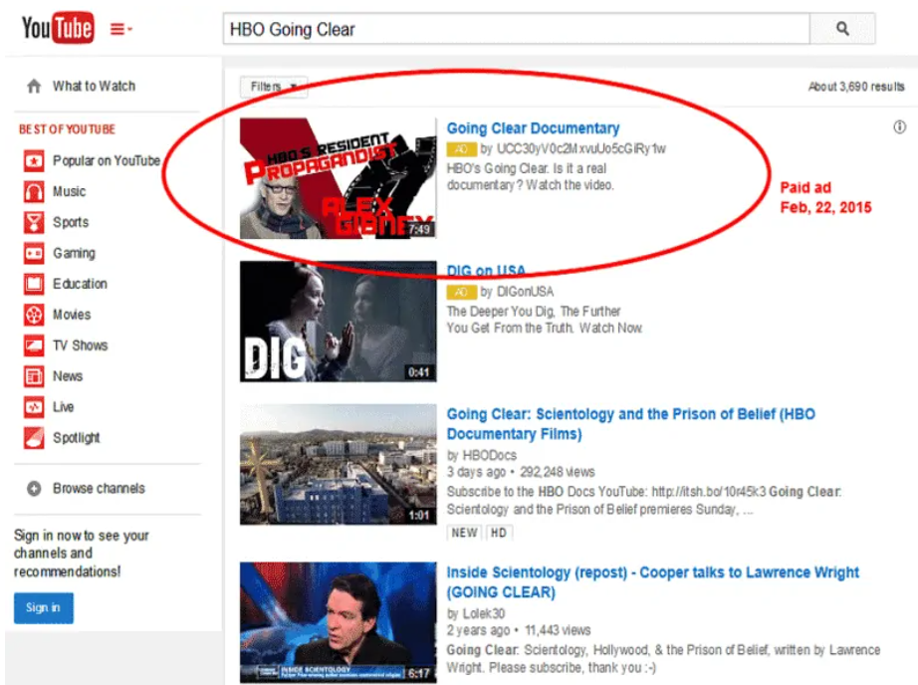
Sponsored Videos
Sponsored advertisements is one of the ways YouTube makes money is through.
Circled Picture (in right) is a paid ad. It is a sponsored video, and the advertiser pays YouTube based on the views and clicks.
It is called SERP advertising.

Slide 7

Embedded Advertisements
Embedded advertisement are played before the actual video begins.
To generate income, ads are played in between of videos, and generate income on the basis of views, an ad gets.
A proportion of that fee is paid to the creator of the video.

Slide 8
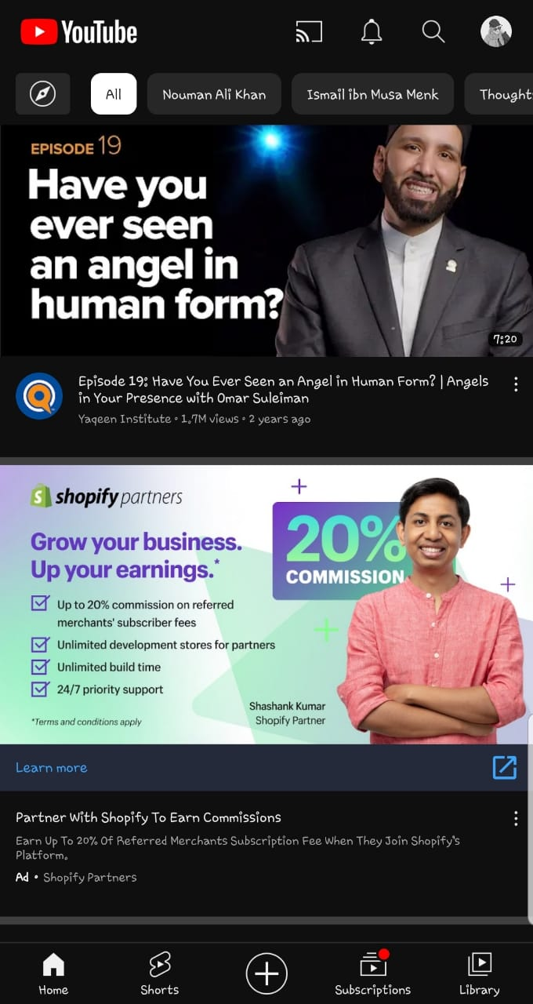
Landing Page Advertisements
A Landing page is YouTube’s homepage — which opens first.
It is a banner-style advertisement that can contain both pictures and videos and can be used by advertisers in numerous ways to shout out loud the story.

Slide 9
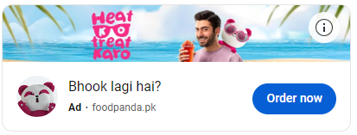
YouTube Premium
Just like Netflix, YouTube has also launched its subscription-based premium revenue model, YouTube Premium, which gives you an enhanced, uninterrupted experience across YouTube, YouTube Music, and YouTube Gaming.
Ad-free videos
YouTube Music Premium access
Offline videos and songs
Access to exclusive YouTube Premium content
Background play when using other apps or when your screen’s off

Slide 10
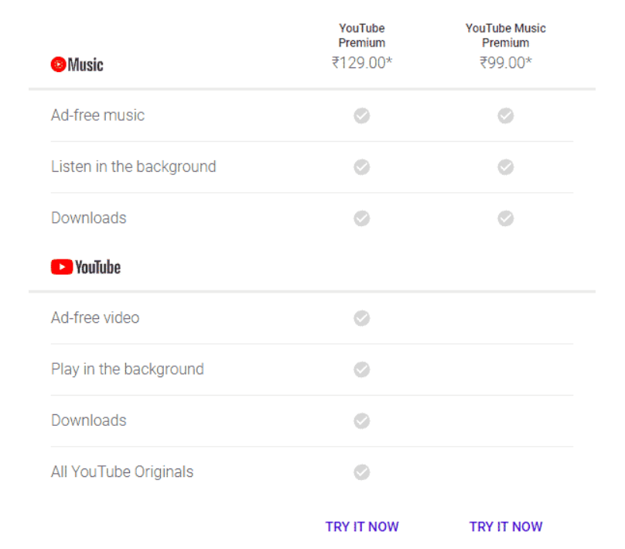
Continued..
The subscription cost to join YouTube Red is $11.99 per month in the USA but it differs for different countries.

Slide 11
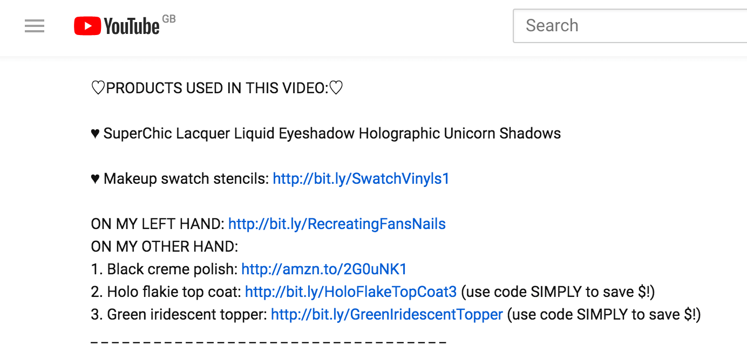
Affiliate Earning
creators can include affiliate links in their video descriptions or on their channel pages. When viewers click on these links and make a purchase, the affiliate (in this case, YouTube) earns a commission on the sale.
These products link to the affiliate partners which pay a commission to YouTube if you buy their products.

Slide 12
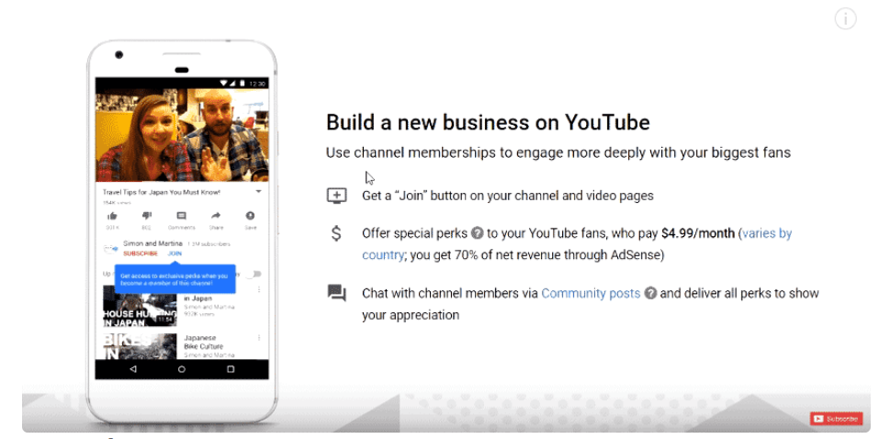
Channel Membership
Custom badges and emojis:
Exclusive content:
Merchandise discounts:
It allows the creator to offer special perks like merchandise, offers, and discounts of of$4.99/month ficial products, etc. to the subscribers who pay (different for different countries).
YouTube keeps 30% of the membership fee paid by the subscriber.

Slide 13
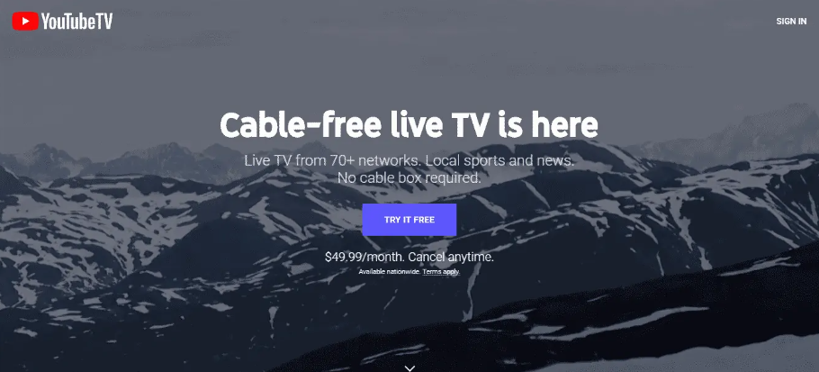
YouTube TV
YouTube TV is a US-exclusive live TV streaming service and offers broadcast networks, cable networks, and.
It is a subscription-based service and is expanding at a fast rate.
It costs $49.99/month and lets you stream from over 70 networks.
60 Days In | YouTube TV (Free Trial)

Slide 14
How to Create a Channel?

Slide 15
4 steps
How to create channel?
How to fix settings?
How to customize channel?
How to verify channel?

Slide 16
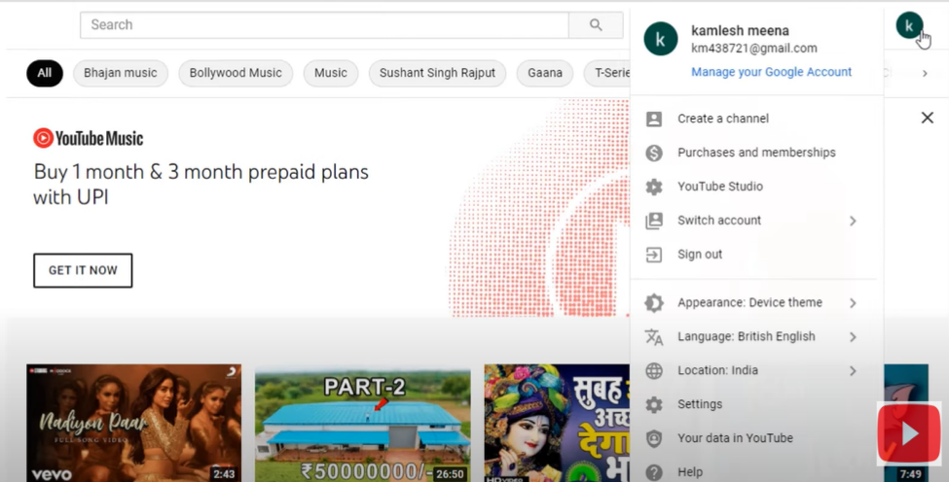
How to create channel?
Sign in

Slide 17
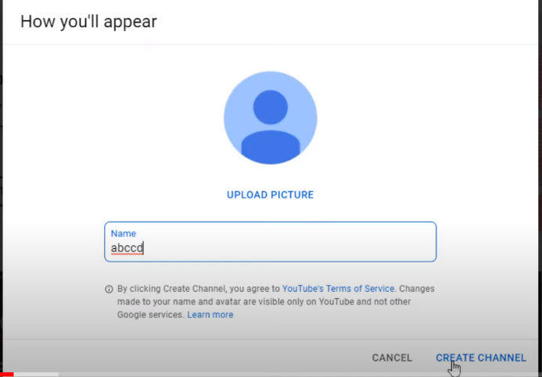
Upload Profile pic and Channel Name

Slide 18
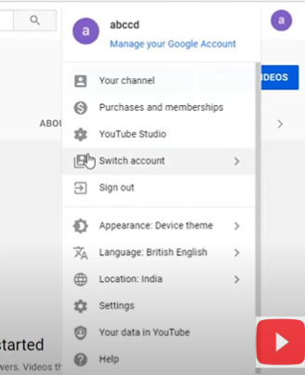
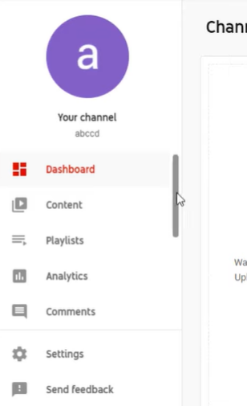
How to fix settings?

Slide 19
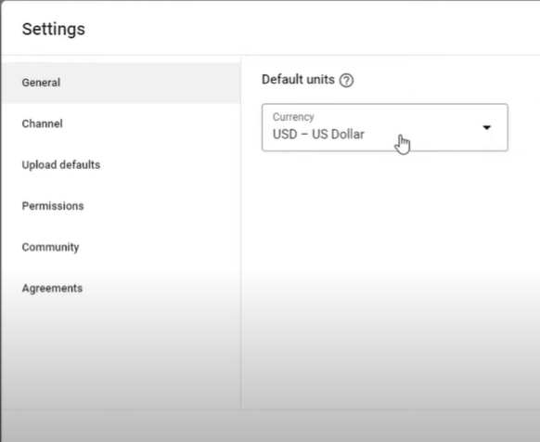
Navigate to Settings
Currency
Country of residence, key words, audience,
Tittle, Description, Tags, Category, Language
Access

Slide 20
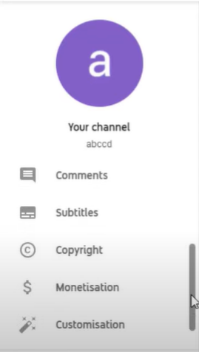
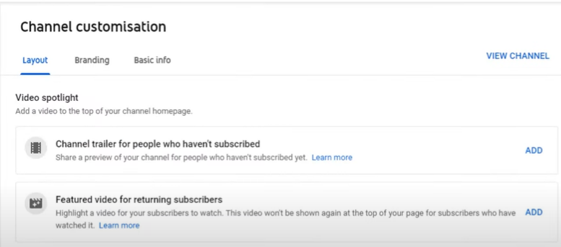
How to customize channel?

Slide 21
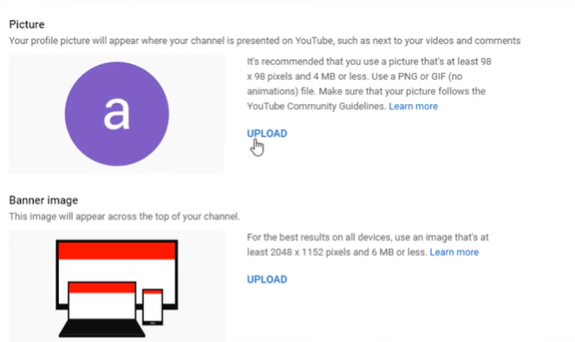
Branding

Slide 22
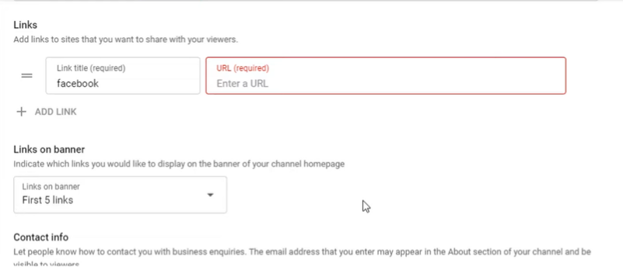
Basic Info
Description
Channel URL
Social Links
Links on Banner
Contact Info

Slide 23
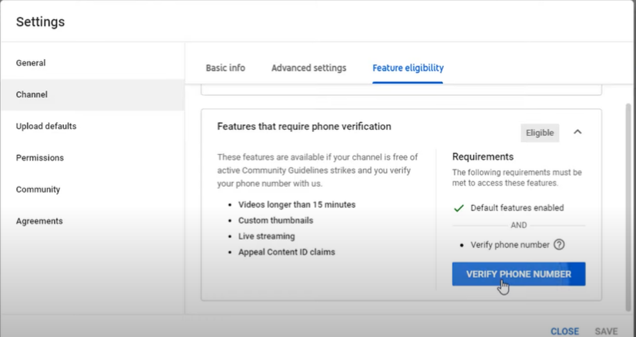
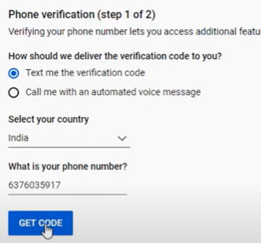
How to verify channel?

Slide 24
But how does Creators make money on YouTube?

Slide 25
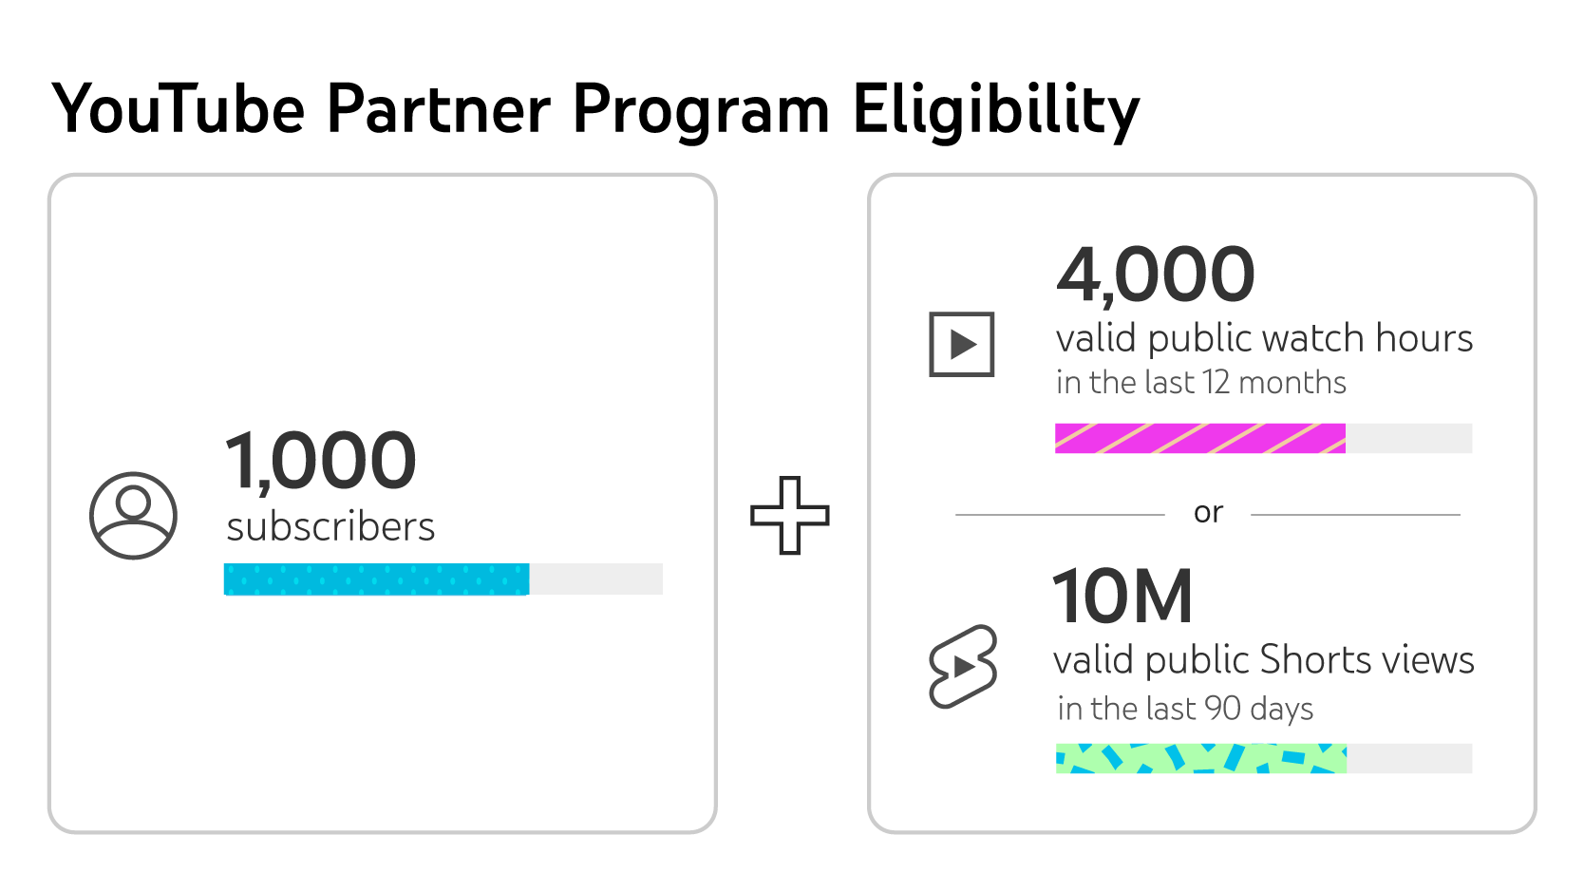
Join the YouTube Partner Program
YouTube offers this program, and it allows content creator to monetize their videos through advertising.
45% YouTube
55% Creator
Advertisements are displayed before or during the video,

Slide 26
What YouTube Checks when Reviews Channel?
Main Theme
Most Viewed Videos
Newest Video
Biggest proportion of Watch Time (YouTube Analytics)
Video Metadata(Thumbnails, Titles, Descriptions)

Slide 27
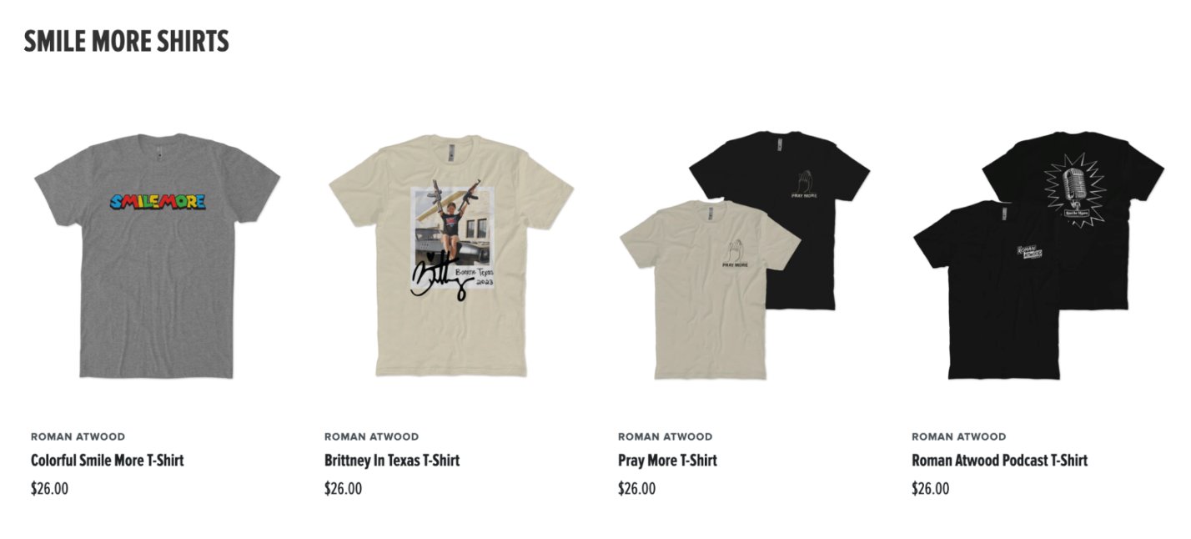
Sell products or merchandise
YouTubers can sell plenty of different products to make money through YouTube channels.
Merchandise shelf: Selling merch—t-shirts, coffee mugs, tote bags, snapbacks, you name it—has a benefit beyond revenue. Creators must be a part of YouTube Partner Program.

Slide 28
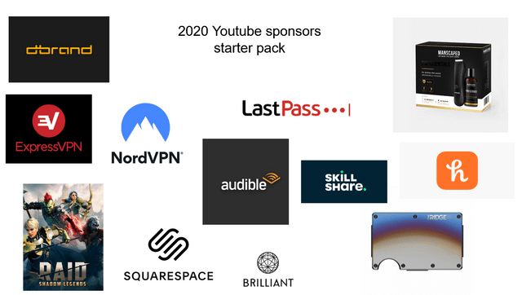
Sponsorships
Sponsorship is when a brand or company pays a YouTuber to create content or service. featuring their product

Slide 29
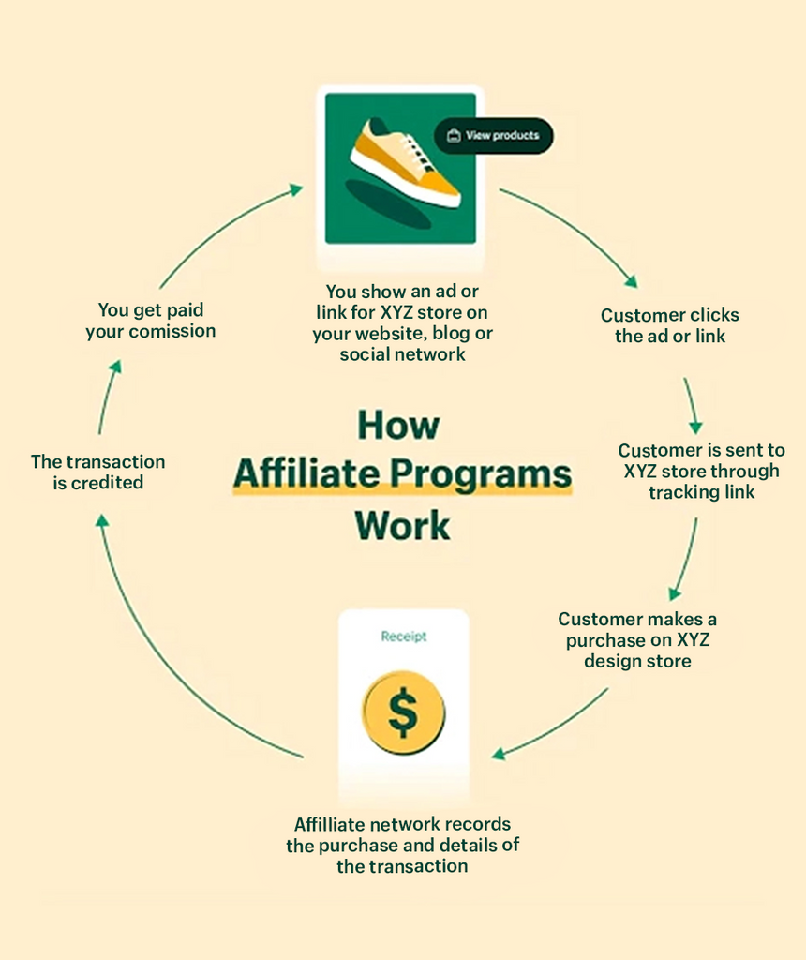
Become an affiliate marketer
Promoting a product or service through a link.
When a viewer clicks on the link and makes a purchase, the YouTuber earns a commission on the sale.

Slide 30
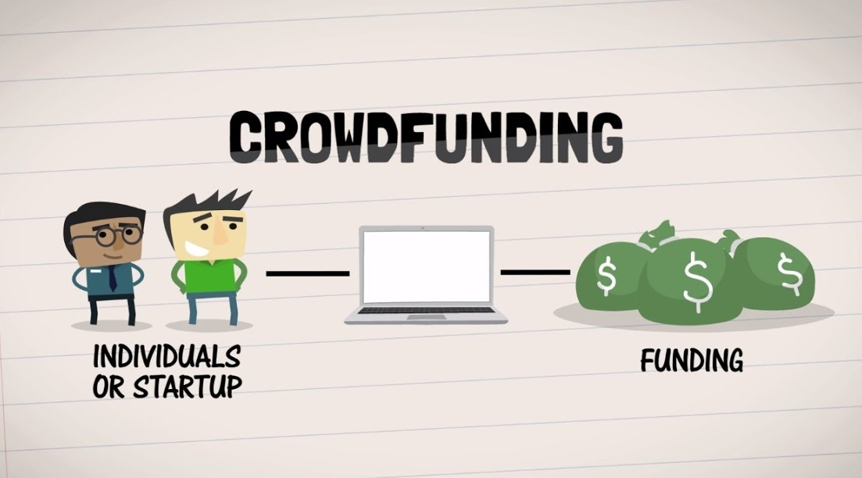
Crowdfund your next creative project
Crowd funding on YouTube is a way for content creators to raise funds from their fans and supporters in order to support their projects or goals.
Creators typically use platforms like Kickstarter, Patreon, or GoFundMe to facilitate the crowdfunding process, and they promote their campaigns through their YouTube channels and social media accounts.

Slide 31
Support you through “fan funding”
It is a way for YouTube creators to receive financial contributions from their viewers. It allows viewers to support their favorite creators by making voluntary monetary contributions through a variety of platforms, including YouTube's own Crowdfunding feature called "channel memberships" or third-party platforms like
Super chat
Super Thanks
Membership
30,000 subscribers

Slide 32
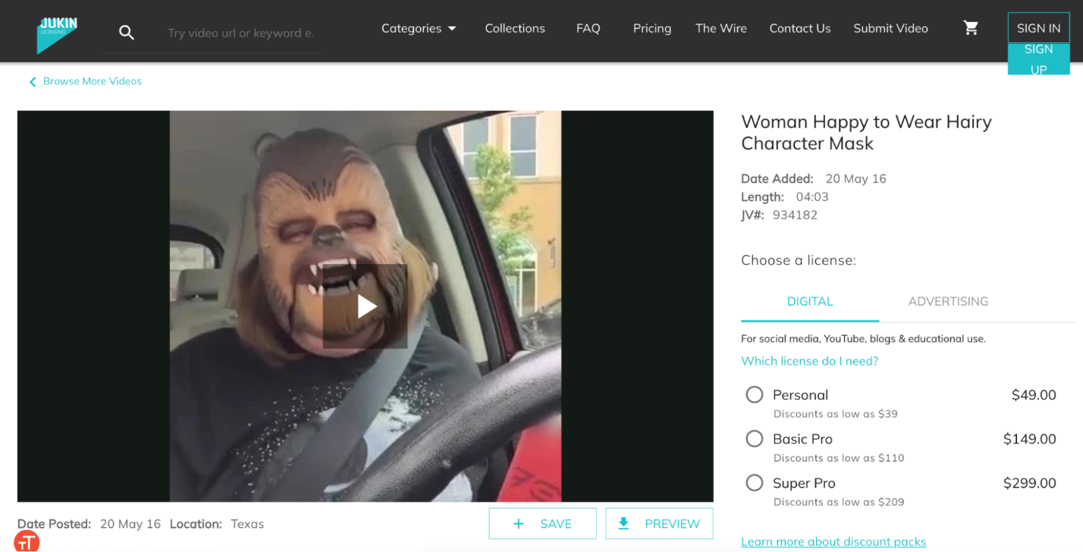
License your content to the media
If you happen to create a viral video with mass appeal—say, a funny clip featuring your dog—you can license your content in exchange for money.
TV news outlets, morning shows, online news sites, and other creators might reach out about rights to use your videos if they happen to go viral.
When this video of a woman wearing a Chewbacca mask went viral, tons of media outlets wanted in.

Slide 33
How to get paid on YouTube?

Slide 34
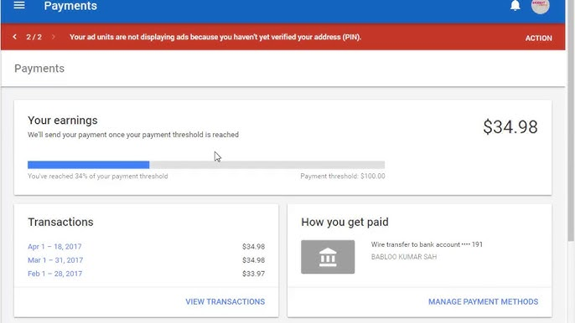
How to get paid on YouTube?
When your earnings reach the payment method selection threshold, you can select your form of payment. Depending on your payment address, the following options may be available to you:
Check
Electronic Funds Transfer (EFT)
Wire Transfer

Slide 35
How much money do You Tubers make per year?

Slide 36
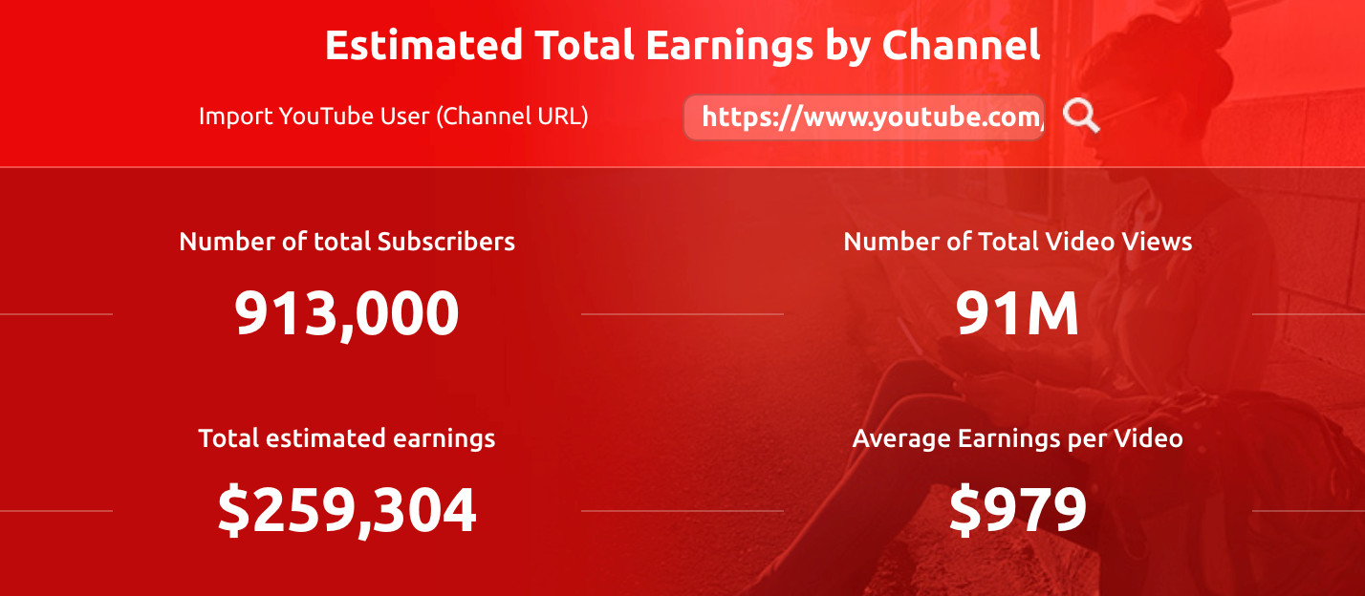
How much money do YouTubers make per year?
Some YouTubers such as MrBeast, Like Nastya, Dude Perfect, and JuegaGerman earn upward of $28.5 million per year through their channels.
According to Influencer Marketing Hub’s YouTube Money Calculator.

Slide 37

Any Questions?

Slide 38


